Slide 1
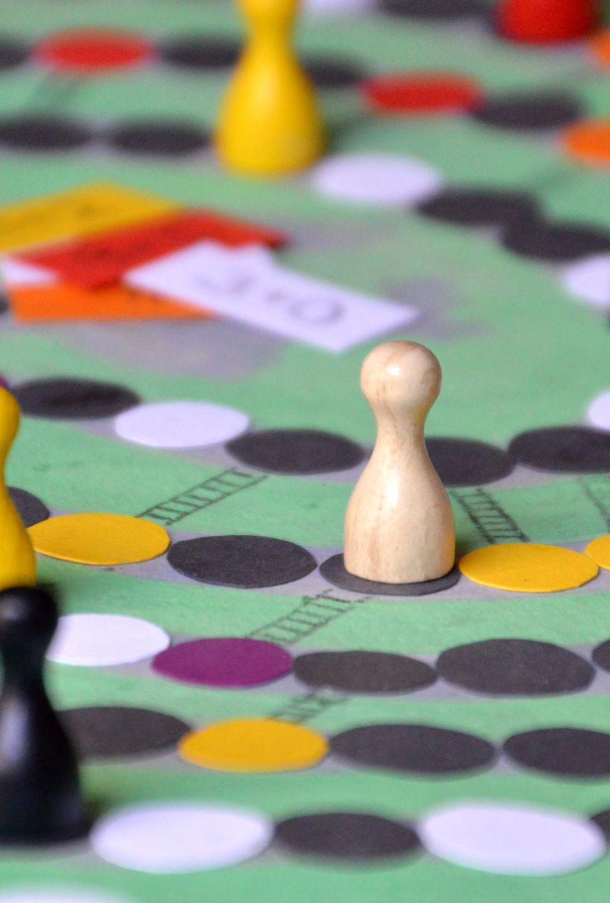
C H 5 4 3 0
Principles of Game Theory
Class 2

Slide 2
What is Game Theory?

Slide 3

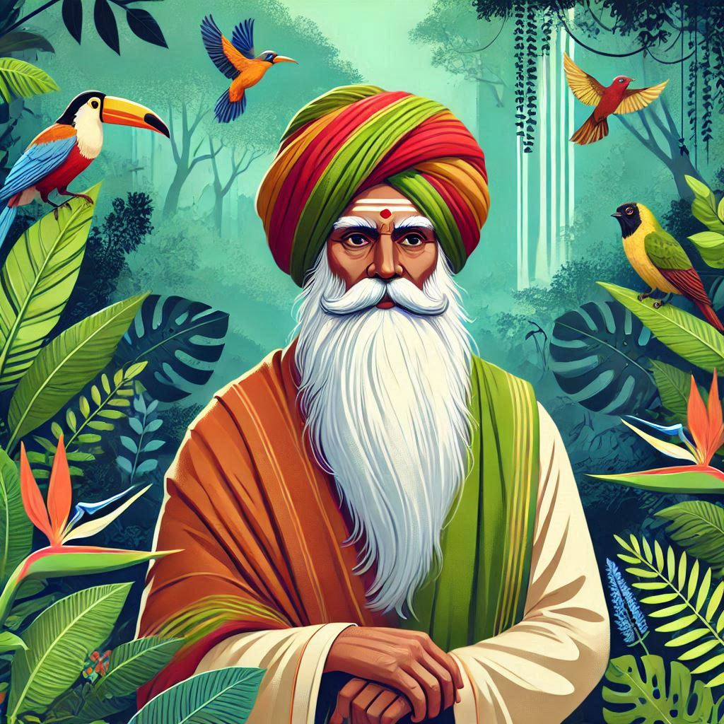
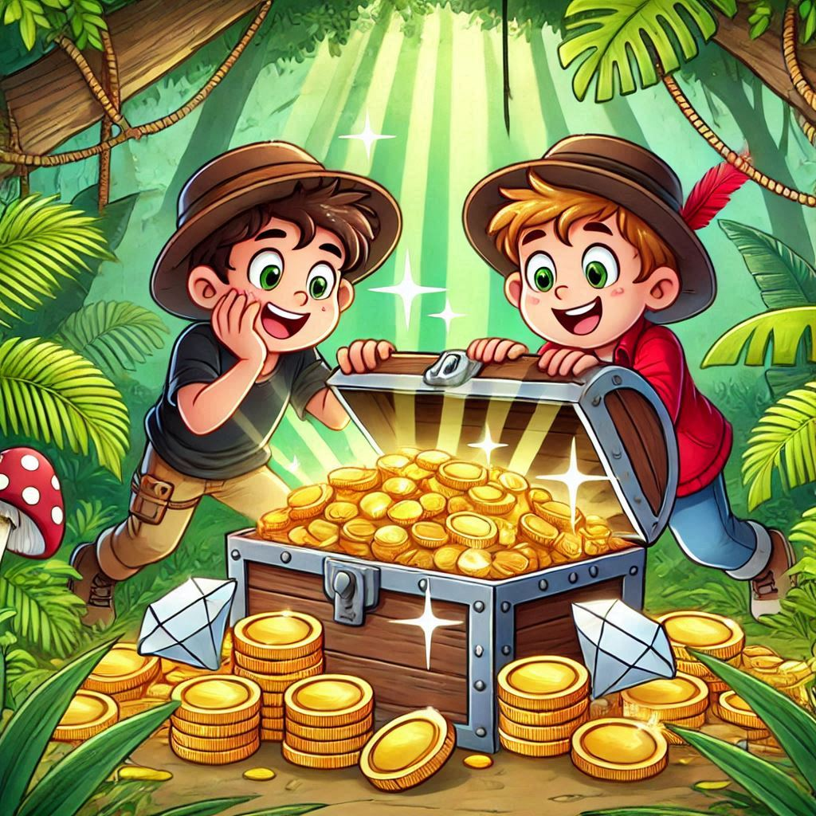
Jungle Treasure
SHARE
TAKE
REVIEW
Google Classroom
Code: 45g3mt55
YOUR TURN
In the Google Form—
Question 1: Secretly choose SHARE or TAKE.
Question 2: Briefly explain why your choice is the better option.
Your choice will be randomly paired with a classmate’s response.
The Outcomes (…after collecting the two cards)
If both of you write SHARE, then the treasure is split equally.
If one writes SHARE and the other writes TAKE, the person who wrote TAKE gets the whole treasure, while the one who wrote SHARE gets nothing.
If both of you write TAKE, you’ll each get only a quarter of the treasure, and the wise old man keeps the remaining half.

Slide 4
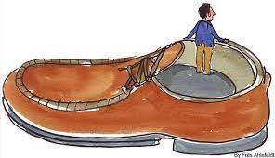








Reflections: Why Select TAKE?
Fear of the worst outcome: Picking SHARE may lead to me getting nothing. TAKE guarantees that I’ll get at least a quarter of the treasure. TAKE is the safer option.
Unilateral thinking
My Friend
…but my outcome depends on not only my own action but also that of my friend.
$$S$$
$$T$$
Hoping for the best outcome: TAKE gives me a chance to get the whole treasure.
$$S$$
$$H, H$$
$$N, W$$
Distrust: I expect my friend to choose TAKE, so choosing SHARE will leave me vulnerable.
Me
Strategic thinking
$$T$$
$$W, N$$
$$Q, Q$$
…based on expectations: what I believe my friend will do.
Lack of credibility: Even if I plan to SHARE, I don’t believe my friend trusts me to do that and will therefore choose TAKE.
The Outcome Matrix
Short-Term Gain: Valuing immediate rewards over future friendship, or moral considerations.
Time-based thinking
What if the same scenario repeats in the future?

Slide 5

Reflections: Why Select TAKE?
REVIEW
The game theoretic perspective…
My Friend
$$S$$
$$T$$
Strategic Thinking: No matter what my friend selects, I get a better outcome for selecting TAKE.
$$S$$
$$H, H$$
$$N, W$$
Beliefs
If…then…
Me
$$T$$
$$W, N$$
$$Q, Q$$
The Outcome Matrix

Slide 6

Reflections: Why Select SHARE?
Cognitive
Emotional/Ethical
…what else?
Unclear about the rules
Flawed analysis
Irrational
…a human trait
Behavioral game theory
REVIEW
…a different way of valuing the four outcomes.
My Friend
Payoffs are different from outcomes.
$$S$$
$$T$$
How each outcome is valued
(different for different players)
Consequences of actions
(same for all players)
$$S$$
$$H, H$$
$$N, W$$
Payoffs can be more complex, beyond just the treasure-portion.
Me
$$T$$
$$W, N$$
$$Q, Q$$
Outcome Matrix
Payoff Matrix
The Outcome Matrix

Slide 7





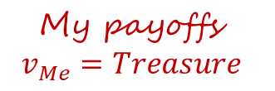




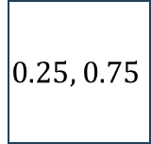







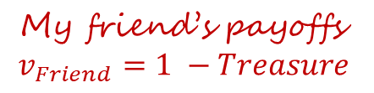
Outcomes vs. Payoffs
The outcomes of strategic situations depend on who is making the decisions.
The same situation can play out differently with different decision-makers.
My Friend
My Friend
$$S$$
$$T$$
My payoffs
$$v_{Me}=Treasure$$
$$S$$
$$T$$
$$S$$
$$0.5, 0.5$$
$$0, 0$$
$$S$$
$$H, H$$
$$N, W$$
Me
Me
$$T$$
$$1, 1$$
$$0.25, 0.75$$
$$T$$
$$W, N$$
$$Q, Q$$
My friend’s payoffs
$$v_{Friend}=1 −Treasure$$
The Payoff Matrix
The Outcome Matrix

Slide 8
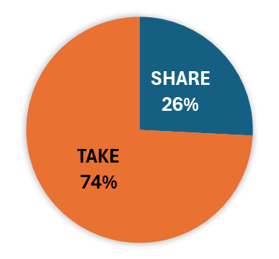
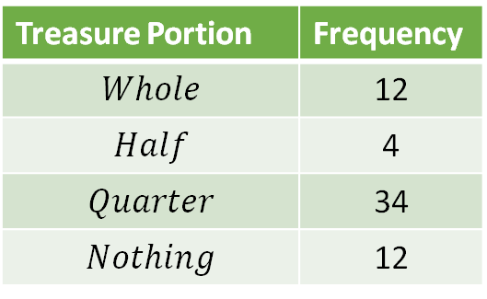
Game Outcomes
My Friend
TAKE
46
$$S$$
$$T$$
SHARE
16
$$S$$
02
$$H, H$$
06
$$N, W$$
Treasure Portion | Frequency
$$Whole$$ | 12
$$Half$$ | 4
$$Quarter$$ | 34
$$Nothing$$ | 12
Me
$$T$$
$$W, N$$
17
06
$$Q, Q$$
The Outcome Matrix

Slide 9
The Consequences of Strategic Thinking
Strategic Thinking: No matter what my friend selects, I get a better outcome for selecting TAKE.
My Friend
$$S$$
$$T$$
Will my friend not use the same logic and select TAKE as well?
$$S$$
02
$$H, H$$
$$N, W$$
The action-pair that will then materialize is (TAKE, TAKE).
The outcome associated with (TAKE, TAKE) is worse for both of us than the outcome associated with (SHARE, SHARE).
Me
$$T$$
$$W, N$$
17
$$Q, Q$$
How can we move from (TAKE, TAKE) to (SHARE, SHARE)?
Communication?
Talk & agree
Make a pact
A suboptimal outcome

Slide 10


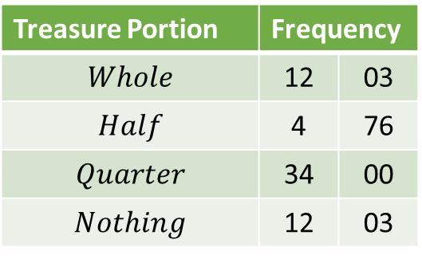
Jungle Treasure: A Second Attempt (A Pact)
Discuss your options with your friend (neighbor) first…
Goal: Grab as much of the treasure as you can!
Make your choice secretly.
TAKE
46
03
Treasure Portion | Frequency
$$Whole$$ | 12 | 03
$$Half$$ | 4 | 76
$$Quarter$$ | 34 | 00
$$Nothing$$ | 12 | 03
My Friend
SHARE
16
79
$$S$$
$$T$$
$$S$$
02
$$H, H$$
$$N, W$$
The outcome associated with (TAKE, TAKE) is worse for both of us than the outcome associated with (SHARE, SHARE).
Me
$$T$$
$$W, N$$
17
$$Q, Q$$
How can we move the outcome from (TAKE, TAKE) to (SHARE, SHARE)?
Can my friend and I reach an agreement before we make our choices?
A suboptimal outcome

Slide 11
The Consequences of Strategic Thinking
Analyzing
Playing
Strategic Thinking: No matter what my friend selects, I get a better outcome for selecting TAKE.
My Friend
$$S$$
$$T$$
Will my friend not use the same logic and select TAKE as well?
$$S$$
$$H, H$$
$$N, W$$
The action pair that will then materialize is (TAKE, TAKE).
The outcome associated with (TAKE, TAKE) is worse for both of us than the outcome associated with (SHARE, SHARE).
Me
$$T$$
$$W, N$$
$$Q, Q$$
How can we move the outcome from (TAKE, TAKE) to (SHARE, SHARE)?
Change the payoffs
Mechanism design
Alter incentives
Freedom of choice intact
Enforcement
Binding contracts
Third-party enforcement
Freedom of choice constrained
Communication?
Talk & agree
Make a pact
A suboptimal outcome
…when communication doesn’t ‘work.’

Slide 12
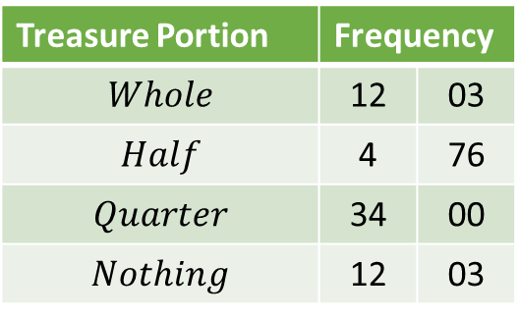
Jungle Treasure: A Second Attempt (A Pact)
Discuss your options with your friend (neighbor) first…
Goal: Grab as much of the treasure as you can!
Make your choice secretly.
REVIEW
The rational choice
TAKE
46
03
Ideal gas
My Friend
Irrational choices!
Real-world human behavior doesn’t always follow the strict rationality that traditional game theory assumes.
SHARE
16
79
‘Ideal’ human beings are rational
$$S$$
$$T$$
Treasure Portion | Frequency
$$Whole$$ | 12 | 03
$$Half$$ | 4 | 76
$$Quarter$$ | 34 | 00
$$Nothing$$ | 12 | 03
$$S$$
$$H, H$$
$$N, W$$
Real humans aren’t always rational
Behavioral game theory
Fairness, empathy
Social norms, classroom vibe
Trust in my friend
Guilt avoidance
Me
$$T$$
$$W, N$$
$$Q, Q$$
Does communication lead to cooperation?
The outcome associated with (TAKE, TAKE) is worse for both of us than the outcome associated with (SHARE, SHARE).
A suboptimal outcome
…when communication ‘works.’
How can we move the outcome from (TAKE, TAKE) to (SHARE, SHARE)?

Slide 13
What is Game Theory?
A strategic dance
A
M
G
‘…Human modeling’
Game theory is the study of making decisions in strategic settings.
…systematic framework to analyze, predict, & prescribe
…where the outcome depends not only on your own choices but also on the choices of others.
TAKE-SHARE
…distinct from a single-person decision problem
…human interactions are complex
…a mathematical framework for modeling strategic interactions among rational agents, where the outcomes depend on the choices of all participants
Game: A mathematical model of a strategic interaction
Entertainment
Winners
Losers
Players
Actions
Outcomes
Preferences
Rational agents
Options
Results
Payoffs
Functions of combinations of actions of all players

Slide 14
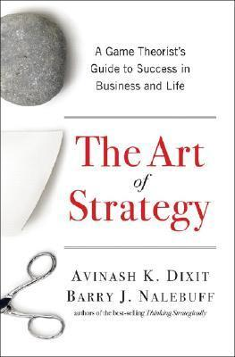
Our Approach
Conceptual Foundation: Depth over breadth
Self-sufficient
A first course in game theory
Principles, not applications
Formal approach
+ Some Fun

Slide 15
Types of Games
Information
…strategic decision making
Static Complete
Dynamic Complete
Dynamic Incomplete
Static Incomplete
Full knowledge of the game structure
Uncertainty about other players' preferences, or actions
Simultaneous one-move games
Sequential moves
Time

Slide 16
Structure
…a first course in Game Theory
Section 1
The Single-Person Decision Problem
Section 2
Static Games of Complete Information
Section 3
Dynamic Games of Complete Information
Section 4
Games of Incomplete Information
The Rational Choice Paradigm
Ch 1, 2
Language
Preparatory ideas
Ch 3-6
Ch 7-11
Ch 12, 15

Slide 17
Structure
Section 1
The Single-Person Decision Problem
Section 2
Static Games of Complete Information
Section 3
Dynamic Games of Complete Information
Section 4
Games of Incomplete Information
The Language of Game Theory
The Expected Utility Theory
The Normal-Form Representation
Pure Strategies
Solution Concepts
  Strict Dominance
  IESDS
  Rationalizability
Nash Equilibrium
Mixed Strategies
The Extensive-Form Representation
  Game Trees
  Information Sets
Backward Induction
Subgame-Perfect Equilibria
Player Types
Beliefs
Bayesian-Nash Equilibrium

